Slide 1
DATA SCIENCE FOR ECONOMISTS
ECON 220 LAB
Jafet Baca-Obando
Week 4, Probability and Functions in Python – 09/19/2025

Slide 2
Outline
Empirical probability
Theoretical probability
Creating functions in Python

Slide 3
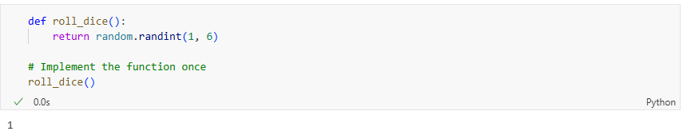
A simple function
This function’s name is roll_dice.
Running this function returns a random integer between 1 and 6 (i.e., 1, 2, 3, 4, 5, or 6)

Slide 4
Theoretical probability
Assuming the die is fair, the theoretical probability will always be 1/6.
That is, there is one in six change of rolling a specific number, say rolling a three.

Slide 5
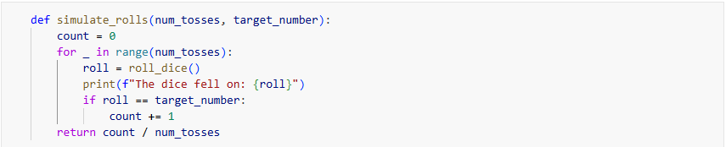
An involved function
This function takes two arguments:
  num_tosses: the number of experiments
  target_number: target result (any number from 1 to 6)

Slide 6
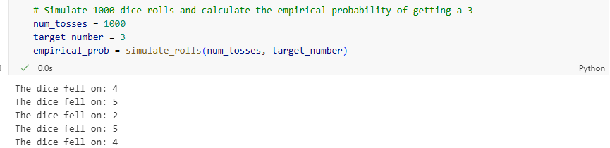
Running the involved function

Slide 7
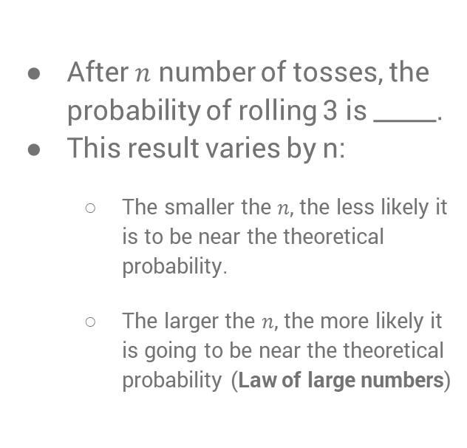

Empirical probability
Theoretical probability
If the dice is fair, the probability of rolling 3 is _____.
This is _____ regardless of the number of tosses, $n$, because there are six sides, each equally likely to happen.
After $n$ number of tosses, the probability of rolling 3 is _____.
This result varies by n:
  The smaller the $n$, the less likely it is to be near the theoretical probability.
  The larger the $n$, the more likely it is going to be near the theoretical probability (Law of large numbers)

Slide 8
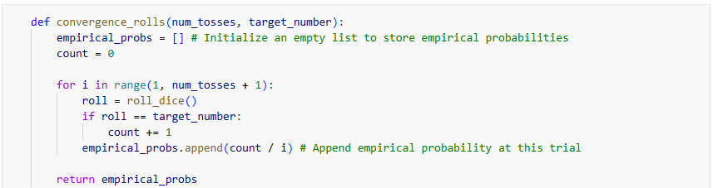
The law of large numbers
Now, we want to get empirical probabilities over the number of trials. Specifically, we’re going to get an average of the probability of rolling a specific number over the number of trials.

Slide 9
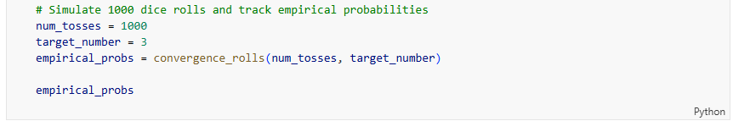
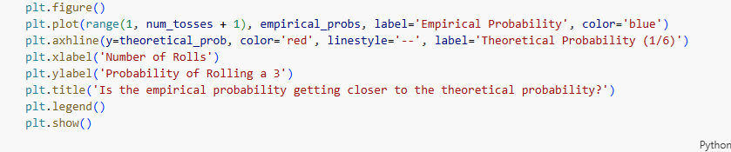
The law of large numbers

Slide 10
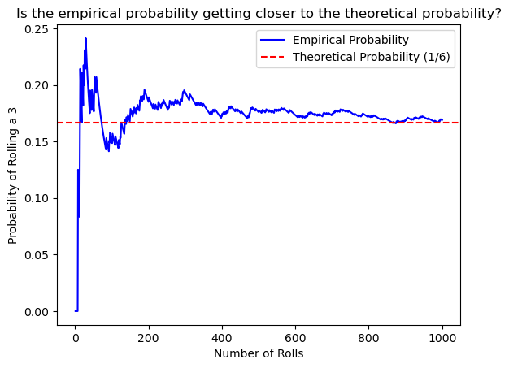
Empirical and theoretical probabilities

Slide 11
Recap
We distinguished between theoretical probability and empirical probability.
We learned how to create our own functions in Python.
We visualized the law of large numbers.

Slide 12
To-do list
Complete Data Exercise 1
  Upload Jupyter notebook (.ipynb file) and HTML file on September 20.
Complete Data Exercise 2
  Upload Jupyter notebook (.ipynb file) and HTML file on September 27.

